Slide 1
Functions and Operator Overloading

Slide 2
Functions
Python Functions is a block of related statements designed to perform a computational, logical, or evaluative task.
The idea is to put some commonly or repeatedly done tasks together and make a function so that instead of writing the same code again and again for different inputs.
we can do the function calls to reuse code contained in it over and over again.
Functions can be both built-in or user-defined. It helps the program to be concise, non-repetitive, and organized.

Slide 3
Syntax:
def function_name(parameters):
statement(s)
return expression
Simple Example:
def fun():
print("Welcome to my home")
Calling a function:
def fun():
print("Welcome to my home")
fun()
Output:
Welcome to my home

Slide 4
Python Function with Arguments
def evenOdd(x):
if (x % 2 == 0):
print("even")
else:
print("odd")
evenOdd(2)
evenOdd(3)
Output:
even
odd

Slide 5
Types of Arguments
Default Arguments
def myFun(x, y=50):
print("x: ", x)
print("y: ", y)
myFun(10)
Output:
('x: ', 10)
('y: ', 50)
Keyword Arguments
def student(firstname, lastname):
print(firstname, lastname)
student(firstname=‘Peter', lastname=‘Paxton')
student(lastname=‘Devi', firstname=‘Vishvakumar')
Output:
(‘Peter', ‘Paxton’)
(‘Devi', ‘Vishvakumar')

Slide 6
Variable Length Arguments
We can pass a variable number of arguments to a function using special symbols.
There are two special symbols:
*args (Non-Keyword Arguments)
*kwargs (Keyword Arguments)
Example 1: Variable length non-keywords argument
def myFun(*argv):
for arg in argv:
print(arg)
myFun('Hello', 'Welcome’, ‘Home’)
Output:
Hello
Welcome
Home

Slide 7
Example 2: Variable length keyword arguments
def myFun(**kwargs):
for key, value in kwargs.items():
print("%s == %s" % (key, value)
myFun(first=‘Hello', mid=‘Salut', last=‘Hola’)
Output:
first == Hello
mid == Salut
last == Hola

Slide 8
Call by Value and Call by Reference
Python utilizes a system, which is known as “Call by Object Reference” or “Call by assignment”.
In the event that you pass arguments like whole numbers, strings or tuples to a function, the passing is like call-by-value because you can not change the value of the immutable objects being passed to the function.
Whereas passing mutable objects can be considered as call by reference because when their values are changed inside the function, then it will also be reflected outside the function.

Slide 9
Example:Call by Value
string = “Bonjour"
def test(string):
string = “MerciBeaucoup"
print("Inside Function:", string)
test(string)
print("Outside Function:", string)
Output:
Inside Function: MerciBeaucoup
Outside Function: Bonjour

Slide 10
Example: Call by Reference
def add_more(list):
list.append(50)
print("Inside Function", list)
mylist = [10,20,30,40]
add_more(mylist)
print("Outside Function:", mylist)
Output :
Inside Function [10, 20, 30, 40, 50]
Outside Function: [10, 20, 30, 40, 50]

Slide 11
Introduction
Operator overloading lets classes intercept normal python operations.
Classes can overload all python expression operators.
Classes can also overload build-in operators.
Such as printing, function calls, attribute access and etc.
Overloading makes class instances act more built-in types.
Overloading is implemented by providing specially named methods in a class.

Slide 12
Python magic functions used for operator overloading
Binary Operators
Comparision Operators
Assignment Operators
Unary Operators

Slide 13
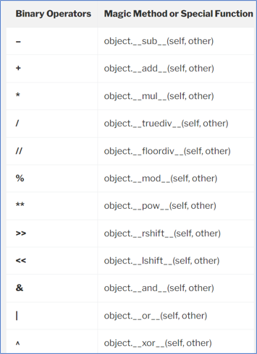
Binary Operators

Slide 14
Example for Binary Operators
class complex_1:
def __init__(self, X, Y):
self.X = X
self.Y = Y
def __add__(self, U):
return self.X + U.X, self.Y + U.Y
Object_1 = complex_1(23, 12)
Object_2 = complex_1(21, 22)
Object_3 = Object_1 + Object_2
print (Object_3)
Output
(44, 34)

Slide 15
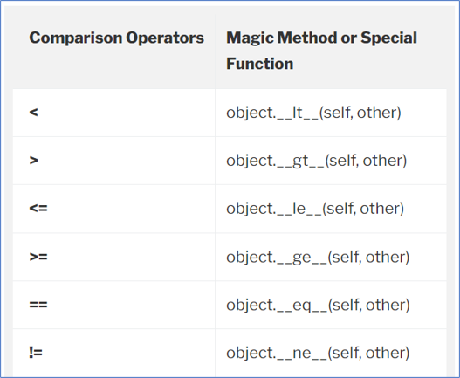
Comparision Operators

Slide 16
Example for Comparision Operators
class Example: def __init__(self,a): self.a = a def __gt__(self,other): return self.a > other.a obj1 = Example(1) obj2 = Example(2) print (obj2 > obj1)
Output:
True

Slide 17
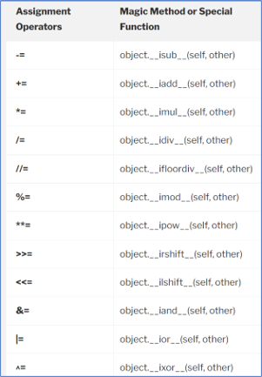
Assignment Operators

Slide 18
Example for Assignment Operators
class Example: def __init__(self,a,b): self.a = a self.b = b def __str__(self): return "({0},{1})".format(self.a,self.b) def __iadd__(self,other): self.a += other.a self.b += other.b return Example(self.a,self.b) obj1 = Example(1,2) obj2 = Example(2,3) obj2 += obj1 print (obj2)
Output:
(3, 5)

Slide 19
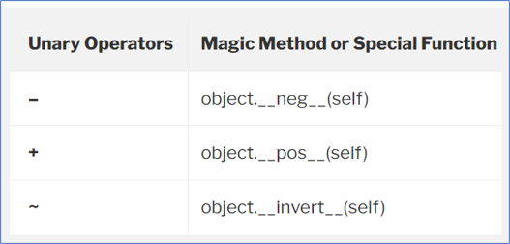
Unary Operators

Slide 20
Example for Unary Operators
class vector:
def __init__(self, x, y):
self.x = x
self.y = y
def __str__(self):
return "({0},{1})".format(self.x, self.y)
#function for operator overloading
def __neg__(self):
X = -self.x
Y = -self.y
return vector(X, Y)

Slide 21
Continue...
#creating vector objects
v1 = vector(10, 15)
v2 = vector(5, -25)
#using overloaded unary - operator
#with vector objects
v1 = -v1
v2 = -v2
#displaying the result
print("v1 =", v1)
print("v2 =", v2)
Output:
v1 = (-10,-15)
v2 = (-5,25)

